Slide 1
Copyright and Fair Use

Slide 2
Types of Video Usage
Videos for Viewing
Videos for Integration into Projects

Slide 3
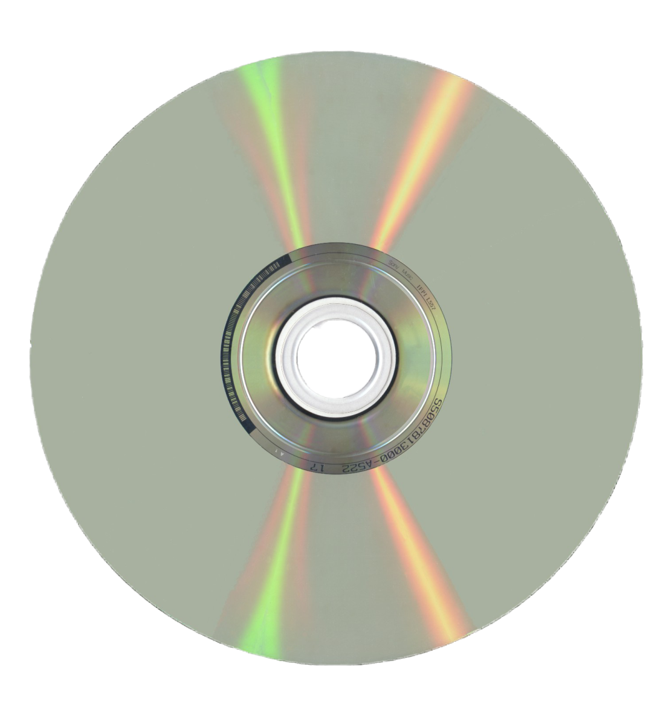
Videos for Viewing
Description
DVDs
Videotapes
Rented
Purchased
Laserdiscs

Slide 4
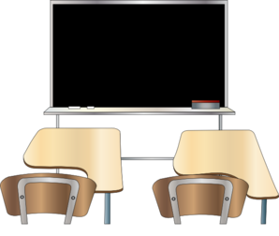
Videos for Viewing
May use in the classroom
May be replaced
if needed

Slide 5
Videos for Viewing
Used in non-profit organization
Instructional use (not for entertainment purposes)
Required in a correct manner

Slide 6
Videos for Integration
Description
Videotapes
DVDs
Movies
Internet Videos
Laserdiscs
Encyclopedias (media)

Slide 7
Videos for Integration
• Students “may use portions of lawfully acquired copyright works in their academic multimedia,” defined as 10 percent or three minutes (whichever is less) of “motion media.”

Slide 8
Videos for Integration
Must be legal copy
Give proper citations and credit

Slide 9
References
https://www.softchalkcloud.com/lesson/files/hlqoNDES9JdiTr/Copyright&FairUsebyTechnologyandLearning.pdf
Canva.com

